Slide 1
Welcome to our presentation
Presented by
Name ID
1.All-amin 213002019
2.Ashikul Haque 213002120

Slide 2
.
Our presentation topic is overloading and overriding

Slide 3
What is overloading
Overloading in Java is the ability to define more than one method with the same name in a class. The compiler is able to distinguish between the methods because of their method signatures.

Slide 4
What is overridding
we can say that Method overloading is a concept of Java in which we can create multiple methods of the same name in the same class, and all methods work in different ways

Slide 5
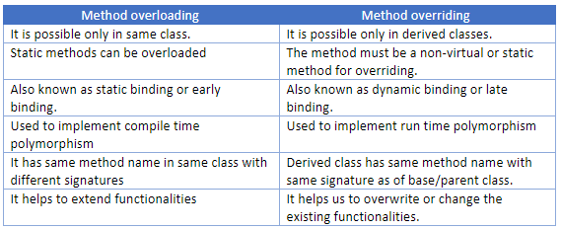
Diffrence between overloading and overriding

Slide 6
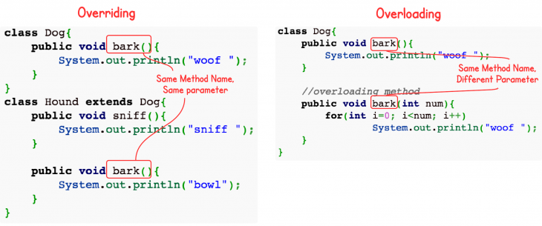
Method Overriding and Method Overloading

Slide 7
.
Method Overriding Example We have two classes: A child class Boy and a parent class Human. The Boy class extends Human class. Both the classes have a common method void eat() . Boy class is giving its own implementation to the eat() method or in other words it is overriding the eat() method.

Slide 8
.
Overriding occurs when the method signature is the same in the superclass and the child class. Overloading occurs when two or more methods in the same class have the same name but different parameters

